Slide 1
Minor Project Report on
Shri Shankaracharya Institute of Professional Management & Technology, Raipur
Traffic Management System
CSE 7th
Semester
Department of Computer Science and Engineering,
Batch 2018-2022
Session Jan – July 2021
Presentation Date: 09/10/2021
Project Guide
Prof. ANAND TAMRAKAR
(Professor, Dept. of CSE)
Project Group Members:
Namrata Sahu, 84
Sonal Dongre, 91
Shivani Dubey, 101

Slide 2
Application Area
This project aims to analyze traffic behaviour and consider vehicles which move different than current traffic behaviour as a possible accident and finally provide a practical solution.
ADVANTAGES:-
It will reduce mostly all traffic accident of vehicles and make driving safe.
It is easy to use and give accurate result.
It will reduce human error to minimal amount.
End Users:-
Car owners and drivers
1

Slide 3
Project Overview
In this project, a solution which will provide the best route to all vehicles will be provided. Our aim is to collect necessary information from neighbour vehicles and process that information using machine learning tools to find the best possible path for all of the vehicles. In our method, vehicles are able to communicate with each other in vehicle-to-vehicle manner which we give the details about the location of one another.
Our system will provide the information about the speed and distance of the cars around us but in a limited area. If there will be any chances of colliding the cars then our system will alert us so that there will be less chances of accidents.

Slide 4
Project Requirements
(End User)
Software’s Required (With Versions duly mentioned)
No software required for end user
Hardware specification :-
Smart camera or vehicles
ADAS and DSM system
3

Slide 5
Project Requirements (Developer)
•Software’s Required (With Versions duly mentioned)
•Python - 3.x(We used python 3.9.6 in this project)
OpenCV - 4.4.0.it is strongly recommended to run DNN models on GPU.
Numpy – 1.20.3.
•Hardware Required :
Smart vehicle and Camera
ADAS and DSM system
3

Slide 6
Front End Details
Front End :-
In our project we will use python as a front end
7

Slide 7
Back End Details
BackEnd :-
Python 3.9.6
Numpy – 1.20.3
4

Slide 8


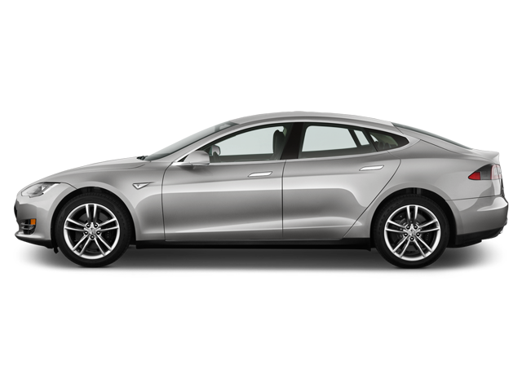
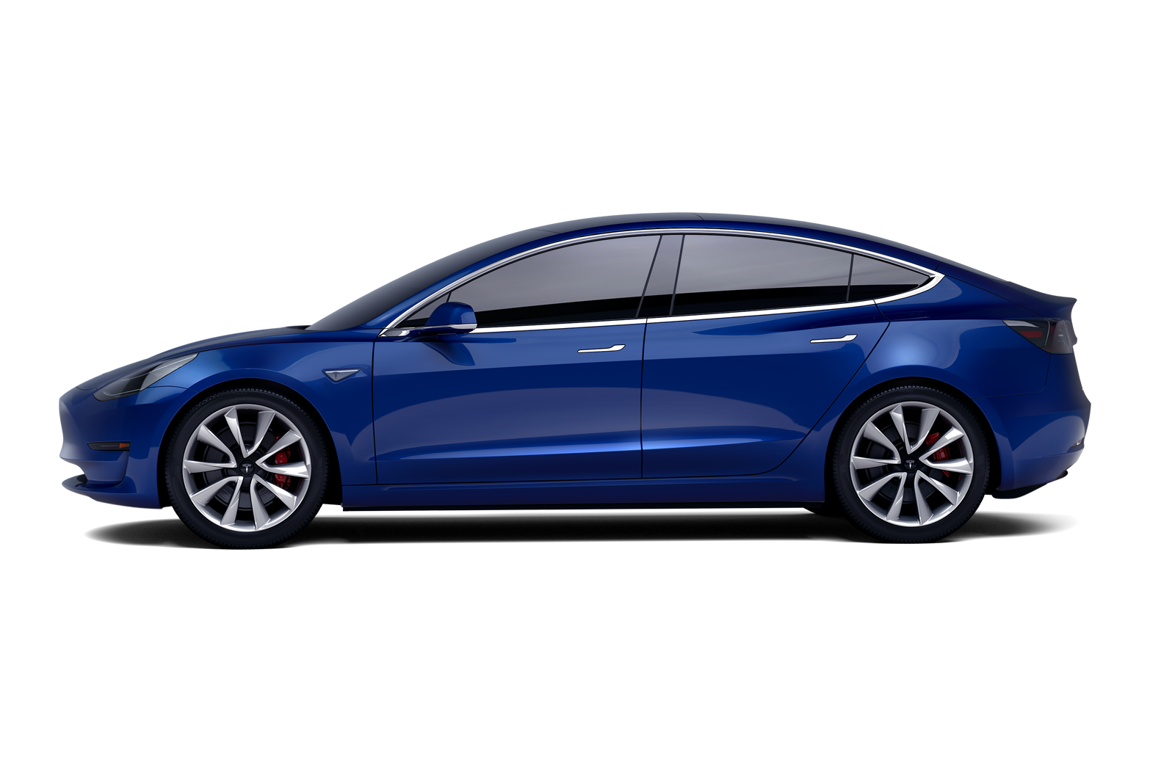
Highway
Safe
40/100
Safe
80/100
Speed-120 km
Speed- 60 km
10 m

Slide 9
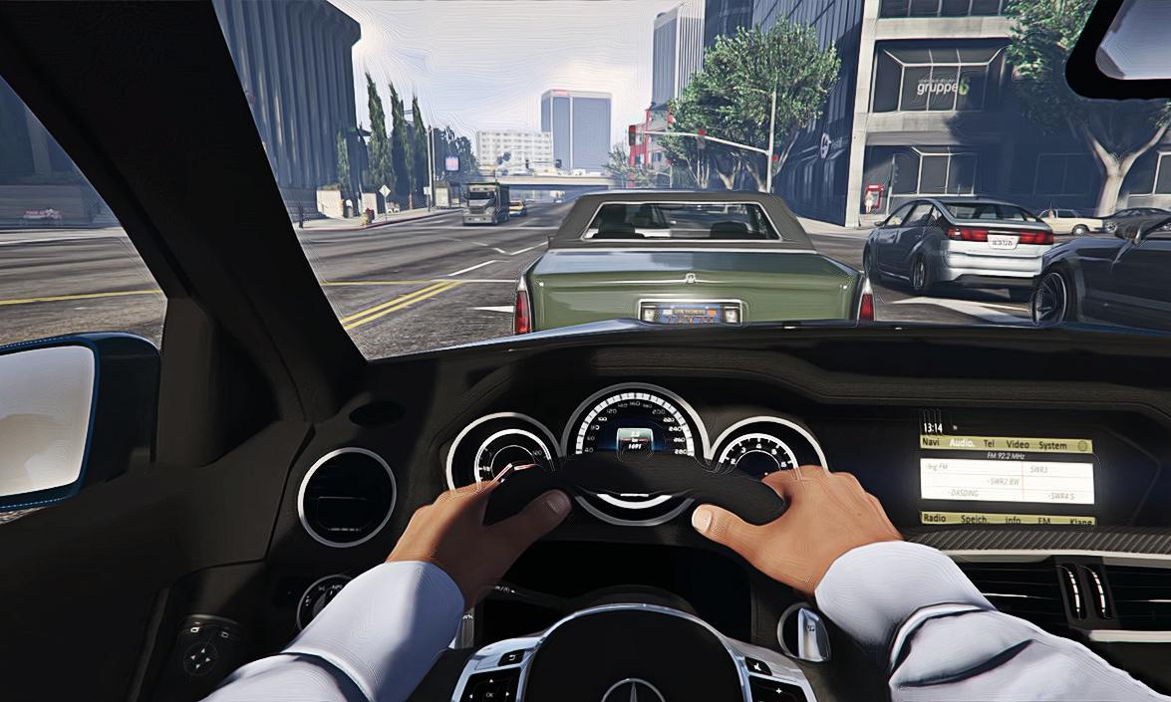
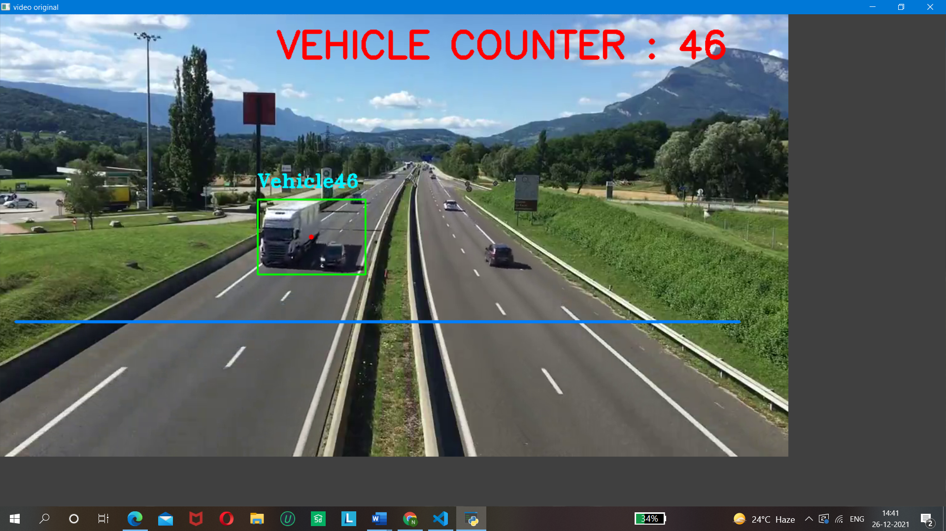


4
S- 80 km
D- 45 m
1
S- 60 km
D- 5 m
3
S- 110 km
D- 10m
2
S- 55 km
D- 6 m
1 .4 vehicles around the car
2. Be safe from 1st and 2nd car
3. Danger, drive slowly &
safely

Slide 10
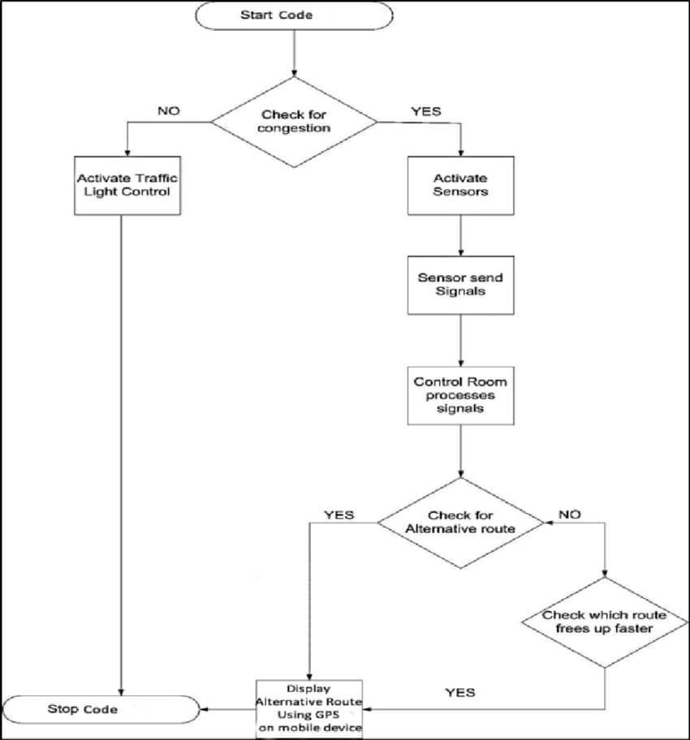
Work Flow Diagram

Slide 11
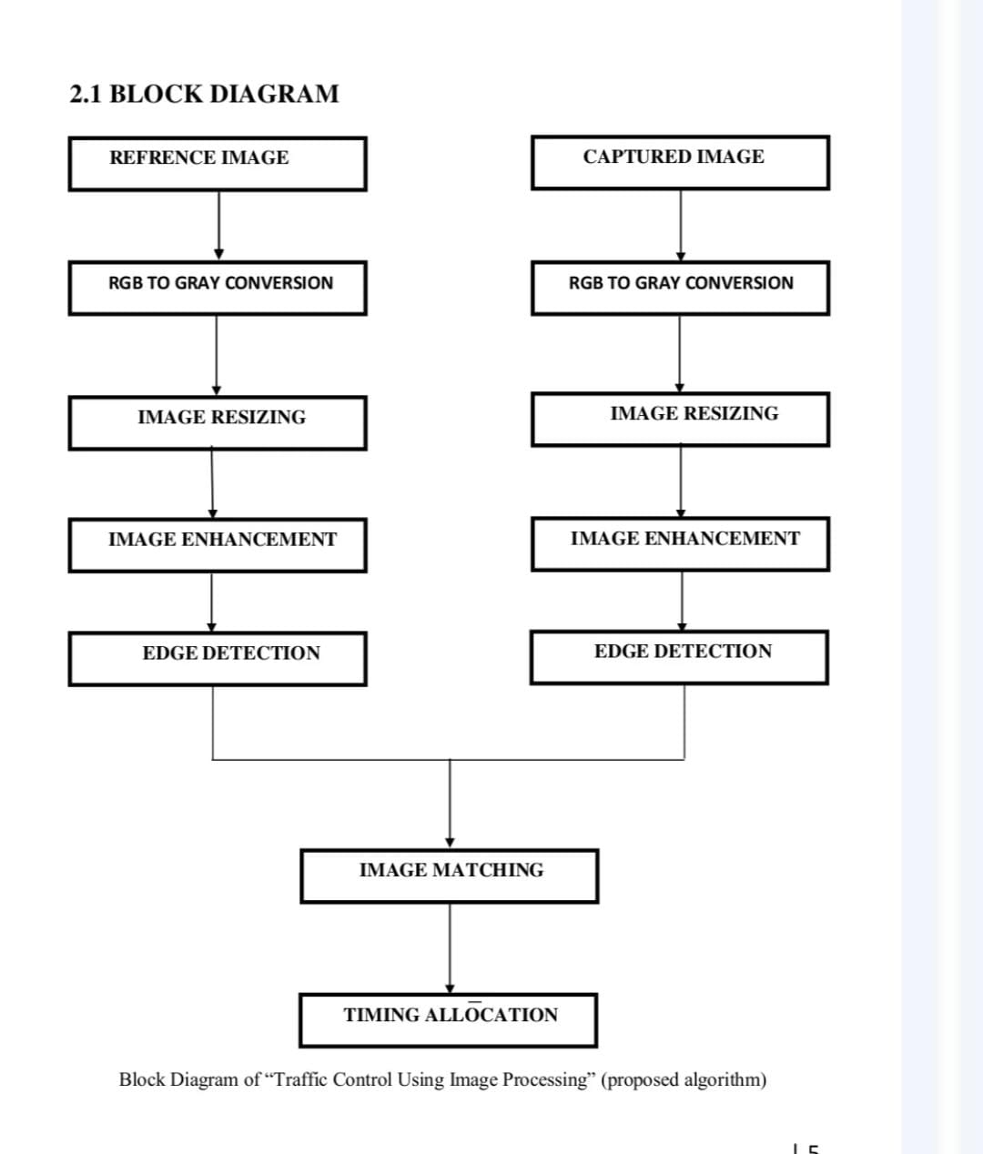
Data Flow Diagram
12

Slide 12
Expected Outcomes
As we know every kind of pollution leaves a huge negative impact on our environment. So, with the help of this project we can reduce the pollution by limiting the traffic jams which will be very useful for our environment, also this project will help in managing the time by finding the best trafficless routes to reach on a particular destination.
This project can also help in reducing the cases of accidents which are more likely to see these days due to heavy traffic.
13

Slide 13
References
Huajun Chai et al. (2017), “Dynamic traffic routing in a network with adaptive signal control”,Transportation Research Part C 85 pp 64–85
Junchen Jin, Xiaoliang Ma (2017) , “A group-based traffic signal control with adaptive
learning ability”, Engineering Applications of Artificial
Khan Mohammad Habibullah, Ahashan Alam, Amit Kumar Das (2019), “A Driver-Centric
Carpooling: Optimal Route-Finding Model Using Heuristic Multi-Objective Search”,
Conference on Computer and Communication
15

